Slide 1
“In the past ideas came from the brain, now they come from Google”

Slide 2
PLAGIARISM
PROF DR MUSTEHSAN BASHIR
DR FATIMA NAUMERI

Slide 3
DISCLOSURE
Nothing to disclose

Slide 4
LEARNING OUTCOMES
At the end of lecture, the participants would be able to
Define plagiarism
Identify it’s types
Define similarity index
Enlist soft-wares for detecting plagiarism
Know editors’ perspectives

Slide 5
OUTLINE
Brief introduction to plagiarism
Hand’s on test cases analysis
Summarization and introduction to similarity index
Enlisting soft-wares for detecting plagiarism
Editors’ perspectives

Slide 6
definition
PLAGIARIUS:
Latin word “kidnapper or kidnapping, theft or a thief of ideas” (McArthur 1992:784)
PLAGIARISM:
“ The appropriation of another person’s ideas, processes, results, or words without giving appropriate credit” (OSTP 2000)¹

Slide 7
TEST CASE 1
DR Z is an expert in congenital diaphragmatic hernia and has published 3 papers on the topic. She plans to write a review article and uses some text from her previous publications. She keeps majority of her text verbatim, while paraphrasing some of her original text. Is she committing research misconduct? If yes, what kind of plagiarism is she committing?

Slide 8
TEST CASE 2
Mr X, a supervisor in surgery department, was given a paper for peer review. While reading it, he noticed a certain phrase which he had come across in another published paper. Then again, there seemed to be differences in writing style within the article. Whereas at times the writer’s style was characteristic of much student work, with occasional grammar and punctuation errors, as well as a certain awkwardness of phrasing, at other times it was extremely sophisticated. On investigation, the writer had plagiarized from different sources. What kind of plagiarism this is and how to avoid it?

Slide 9
TEST CASE 3
Article 1: In ages which have no record these islands were the home of millions of happy birds, the resort of a hundred times more millions of fishes, of sea lions, and other creatures whose names are not so common; the marine residence
Article 2: Long ago, when there was no written history, these islands were the home of millions of happy birds; the resort of a hundred times more millions of fishes, sea lions, and other creatures.
What kind of plagiarism this is? Could it be accidental?

Slide 10
TEST CASE 4
ARTICLE 1: “Go back 250 years in American and European history, and you do not find nearly so many people wandering around remote corners of the planet looking for what today we would call ‘the wilderness experience’.”
ARTICLE 2: Before the 18th century, the wilderness experience was based on people wandering the different corners of planets.
Is the article 2 plagiarized? Why if yes? How if not?

Slide 11
“Once you have transferred copyright to a journal (in order to publish) you can’t ethically use the words that you have written in another journal article; you no longer own those words.”²
GENNARO 2012 p 109

Slide 12
DEFINITION SELF PLAGIARISM
SELF PLAGIARISM:
“Republishing substantive parts of one’s own earlier publications, including translations, without duly acknowledging or citing the original.”
(European Science Foundation 2017)³
Linguistic plagiarism
Text recycling
“Cryptomnesia”

Slide 13
TYPES OF SELF PLAGIARISM
Dual/ Duplicate publications
New publication with little addition to previous one
Redundant publications
Reanalysis of previous published data set²⁻⁴

Slide 14
TYPES OF SELF PLAGIARISM
Segmented publications
Salami slicing of data set for different publications
Text recycling
Cloning without proper reference²⁻⁴

Slide 15
DEFINITION REMIX PLAGIARISM
REMIX PLAGIARISM:
“Remix plagiarism is the act of collecting information from multiple sources, combining into one work by paraphrasing, and then claiming it as your own work, without citations.”⁴
Patchwriting
Hybrid plagiarism
Mosaic plagiarism

Slide 16
DEFINITION direct PLAGIARISM
DIRECT PLAGIARISM:
“Republishing substantive parts of earlier publications (copy/ paste, word to word) without duly acknowledging or citing the original.”⁴
“CLONING” is the worst form of direct plagiarism!

Slide 17
IMPLICATIONS
Copyright violation
Legal action
Defamation and academic fraud
Expulsion
Undue editorial load, peer process^{4,5}

Slide 18
SIMILARITY INDEX
SIMILARITY INDEX:
“The percentage of overlap between text submitted to plagiarism detection and that in original source material. This should not be considered the percentage of a paper that is plagiarized.” (IGI GLOBAL)⁶
The Jaccard index, also known as the Jaccard similarity coefficient, is a statistic used for gauging the similarity and diversity of sample sets.

Slide 19
Identification of plagiarism
Inappropriate citation
Consecutive reproduction
Foreign language
Detection by soft-wares³⁻⁵

Slide 20
SOFT WARES
Déjà vu
eTBLAST
CrossCheck
WCopyfinal
SPlaT
Turnitin
iThenticate
Visual mapping software (VOS)^{4,5}

Slide 22
PREVENTION
Educate about research misconduct
Appropriate citations
Follow COPE guidelines
Copyright guidelines³⁻⁵

Slide 23
REMEDY
Revise manuscript
Withdraw the manuscript
Retract the manuscript
Rejection³⁻⁵

Slide 24
EDITORS’ PERSPECTIVE
Since 1990-2015: 57 editorials in Scopus/ WoS and 75 reports in COPE
ICMJE duplicate submission/publication, acceptable secondary publication, manuscript based on same data set
COPE guidelines for self plagiarism/ suspected plagiarism/ plagiarism in submitted paper
Is plagiarism a failure to cite only?
How to handle post publication plagiarism? ^{3,4}

Slide 25
REFERENCES
Bruton S V. Self-Plagiarism and Textual Recycling: Legitimate Forms of Research Misconduct. Account Res. 2014;21(3):176–97.
Callahan JL. The retrospective (im)moralization of self-plagiarism: Power interests in the social construction of new norms for publishing. Organization. 2018;25(3):305–19.
Lin WYC. Self-plagiarism in academic journal articles: from the perspectives of international editors-in-chief in editorial and COPE case. Scientometrics [Internet]. 2020;123(1):299–319. Available from: https://doi.org/10.1007/s11192-020-03373-0
Roka YB. Plagiarism: Types, Causes and How to Avoid This Worldwide Problem. Nep J Neurosci. 2017;14(3):2-6. https://doi.org/10.3126/njn.v14i3.20517
Arumugam A, Aldhafiri FK. A researcher’s ethical dilemma: Is self-plagiarism a condemnable practice or not? Physiother Theory Pract. 2016;32(6):427–9.
What is Similarity Index | IGI Global. [Internet]. Accessed on August 24, 2021. Available from: https://www.igi-global.com › dictionary › similarity-index

Slide 26
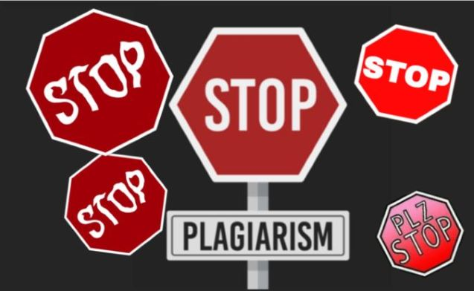
THANK YOU!
Any Questions? Answers: Self (1)/ Remix (2)/ Direct (3)/ Plagiarism (4)

